Slide 1
Direct Memory Access (DMA)
(Lecture 49-50)

Slide 2
Modes of Data Transfer
The transfer can be made in several ways that are:
DMA Burst :- In DMA Burst transfer, a block sequence consisting of a number of memory words is transferred in continuous burst while the DMA controller is master of the memory buses. Used for fast devices such as magnetic disks, where data transmission cannot be stopped or slowed down until an entire block is transferred.
Cycle Stealing :- Cycle stealing allows the DMA controller to transfer one data word at a time, after which it must returns control of the buses to the CPU. CPU is usually much faster than I/O (DMA), thus CPU uses the most of the memory cycles. DMA Controller steals the memory cycles from CPU and CPU remains idle. For slow CPU, DMA Controller may steal most of the memory cycles which may cause CPU remain idle long time.
Transparent Mode: Transparent Mode in DMA does not require any bus in the transfer of the data as it works when the CPU is executing the transaction.

Slide 3
DMA Controller (DMAC)
The DMA controller communicates with the CPU through the data bus and control lines as shown in figure on next slide. DMA select signal is used for selecting the controller, the register select is for selecting the register.
● When the BG (Bus Grant) = 0, the CPU can communicate through the data bus to read or write into the DMA register.
● When BG = 1, the DMA controller takes the control of buses and transfers the data between the memory and I/O.
● The DMA controller has three registers.
● The address register specifies the desired location of the memory which is incremented after each word is transferred to the memory.
● The word count register holds the number of words to be transferred which is decremented after each transfer until it is zero. When it is zero, it indicates the end of transfer. After which the bus grant signal from CPU is made low (BG=0) and CPU returns to its normal operation.
● The control register specifies the mode of transfer which is Read or Write.

Slide 4
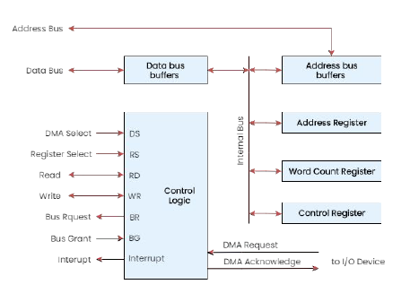
DMA Controller – Block Diagram
Fig: Block diagram of a DMA Controller

Slide 5
DMA Transfer in Computer System
Connection between DMAC and other components of computer (Memory and peripheral devices) is shown in next slide.
Following are the steps for DMA transfer:
I/O Device sends a DMA request.
DMA Controller activates the BR line.
CPU responds with BG line.
DMA puts the current value of its address register into the address bus, initiates the RD or WR signal, and sends a DMA acknowledge to the I/O device.
I/O device puts a word in the data bus (for write) or receives a word from the data bus (for read).
The peripheral unit can then communicate with memory through the data bus for direct transfer between the two units while the CPU is momentarily disabled.
For each word that is transferred, the DMA increments its address register and decrements its word count register. If the word count does not reach zero, the DMA checks the request line coming from the I/O Device.
If there is no request ,the DMA disables BR so that the CPU continues to execute its own program.
When CPU requests another transfer, DMA requests bus again.
If the word count register reaches zero, the DMA stops any further transfer and removes its bus request. It also informs the CPU of the termination by an interrupt.

Slide 6
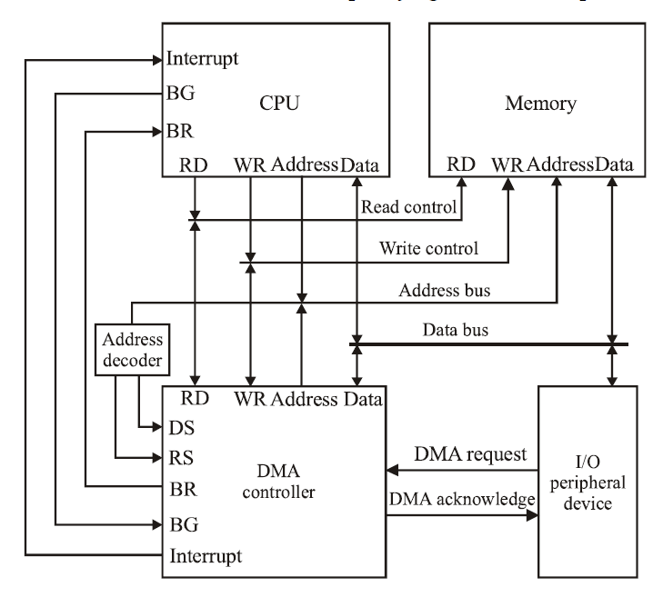
DMA Transfer in Computer System
Fig: Connection between DMAC and other components of computer

Slide 7
Advantages and Disadvantages
Advantages of DMA Controller
Data Memory Access speeds up memory operations and data transfer.
CPU is not involved while transferring data.
DMA requires very few clock cycles while transferring data.
DMA supports large data transfer.
DMA helps the CPU in decreasing its load.
Disadvantages of DMA Controller
Direct Memory Access is a costly operation because of additional operations.
DMA functionality may not be universally supported across all hardware platforms or peripherals.
DMA Controller increases resource conflicts and security risks.
DMA Controller increases the complexity of the software.

Slide 8
Intel 8257 DMA Controller
Features of Intel 8257:-
The chip is supplied in 40-pin DIP package. It has four channels which can be used over four I/O devices.
Each channel has 16-bit address and 14-bit counter.
Each channel can transfer data up to 64kb.
Each channel can be programmed independently.
Each channel can perform read transfer, write transfer and verify transfer operations.
It generates MARK signal to the peripheral device that 128 bytes have been transferred.
Its frequency ranges from 250Hz to 3MHz.
It operates in 2 modes, i.e., Master mode and Slave mode.

Slide 9
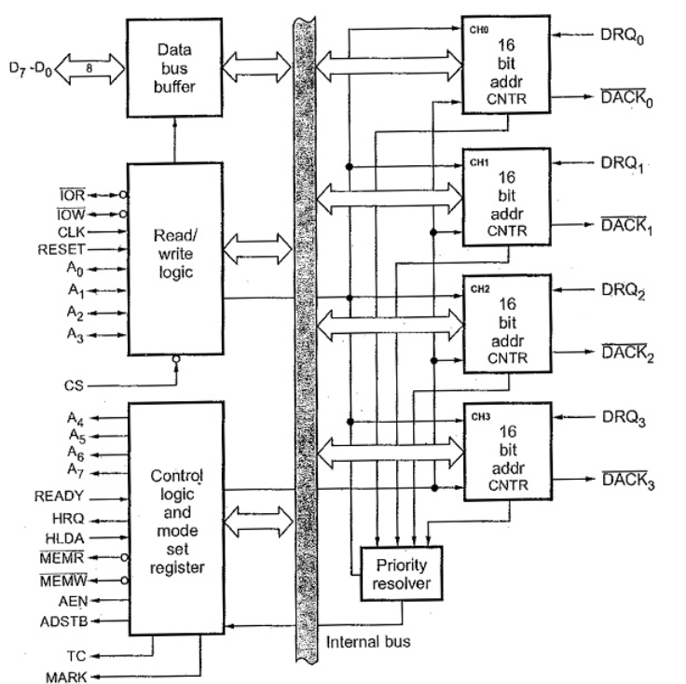
Intel 8257 – Block Diagram
Fig: Intel 8257 – Block Diagram

Slide 10
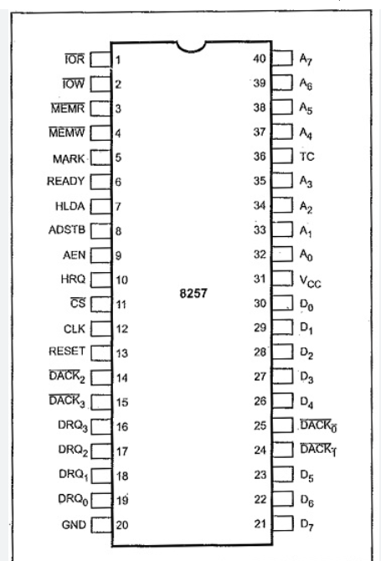
Intel 8257 – Pin Diagram
Fig: Intel 8257 – Pin Diagram

